Slide 1
School Admission Portal
AICT Lab Project
Instructor: Ramsha Khalid | Department of Computer Science

Slide 2
Group Members
Abdullah Akbar CS – 212
Ali Khalid Sethari CS – 220
Sarim Sajjad CS – 191
Maaz Hassan CS – 202
Mujtaba Imtiaz CS – 192

Slide 3
Project Overview & Objectives
To design a responsive school admission website
To apply HTML and CSS for structured web design
To apply HTML and CSS for structured web design
To analyze admission-related data using Microsoft Excel

Slide 4
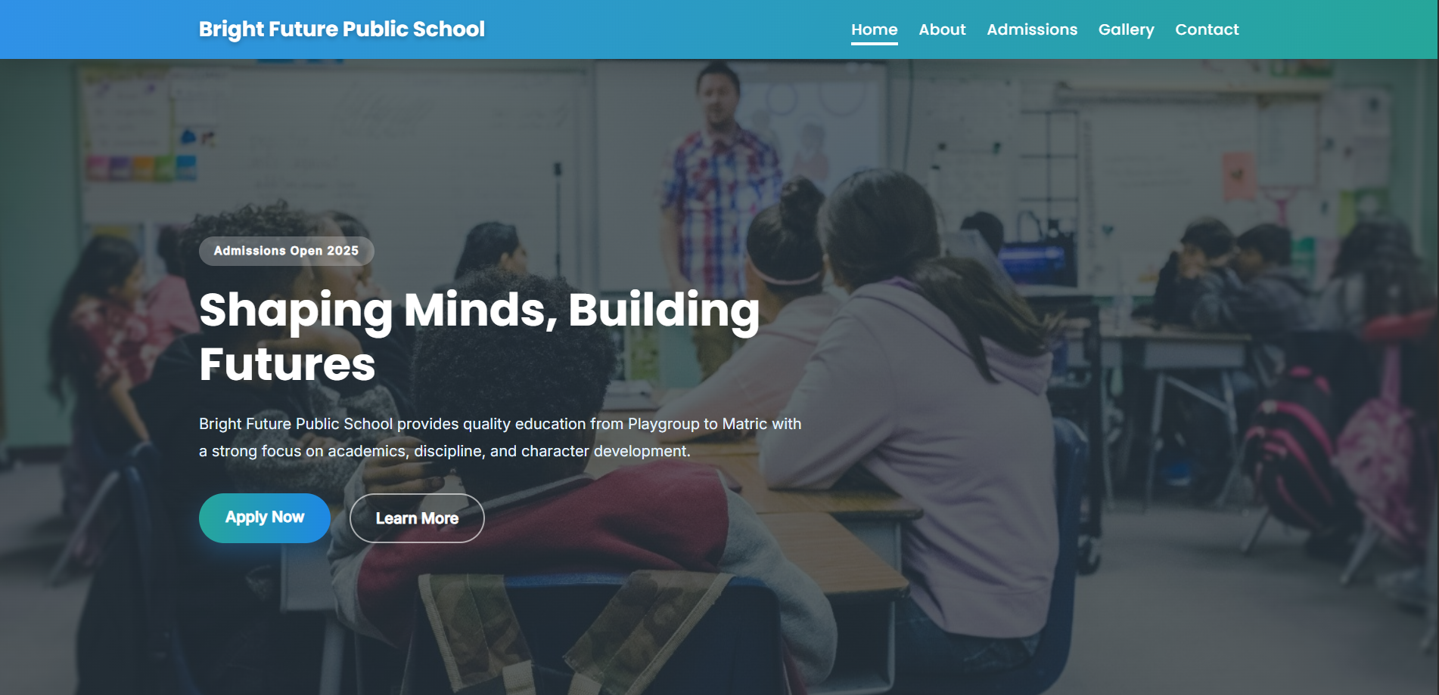
Website Demonstration – Home Page
School introduction and highlights
Clean and responsive layout
Admission announcement and
call-to-action

Slide 5
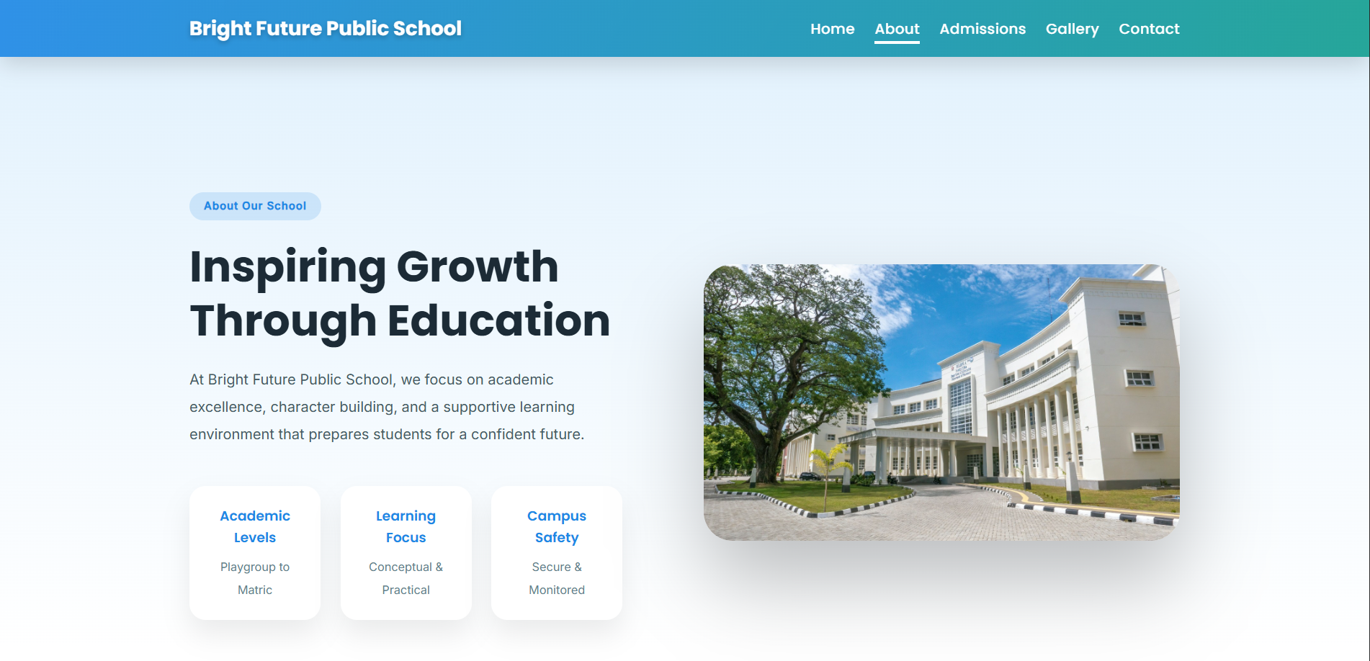
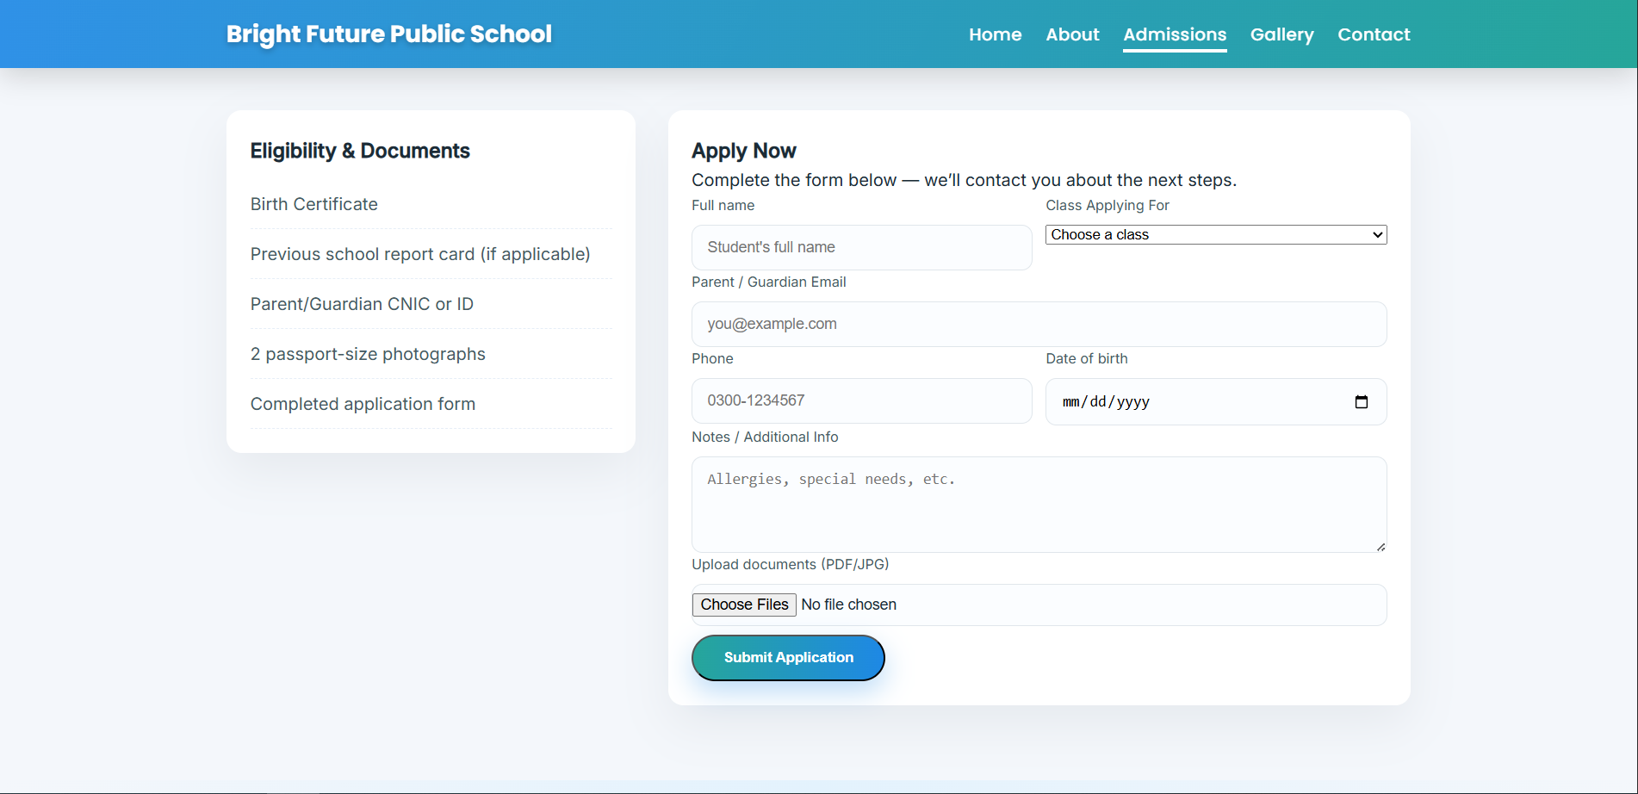
Website Demonstration – About & Admissions
School vision, mission, and values
Admission structure and class levels

Slide 6
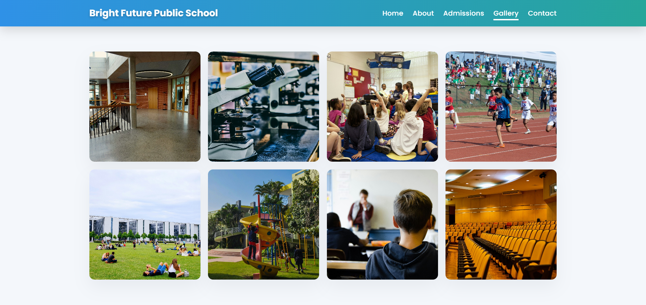
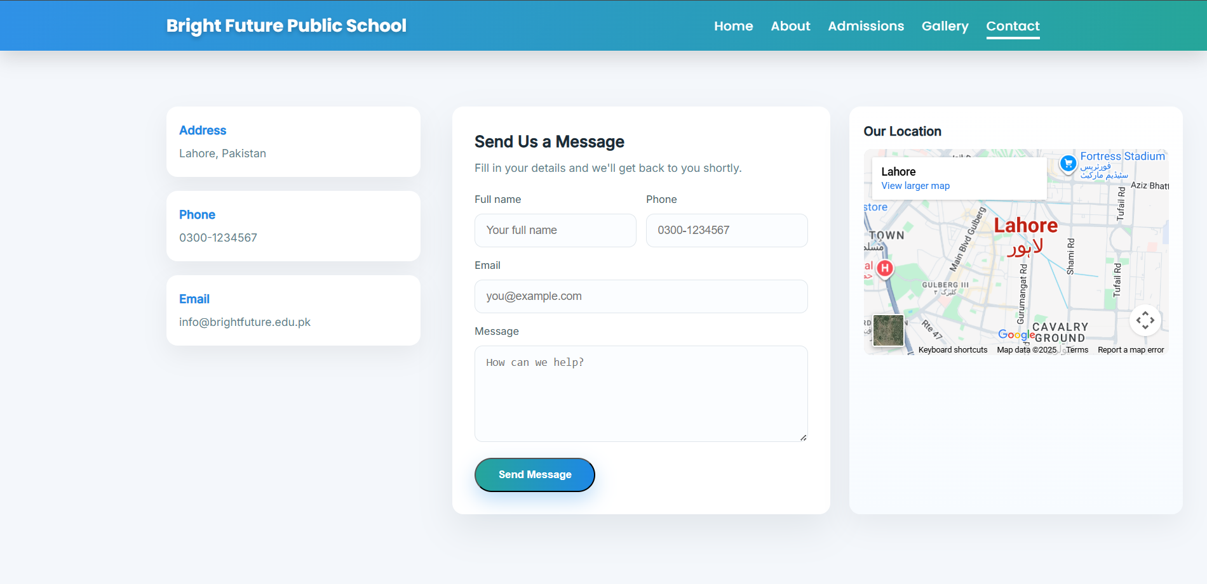
Website Demonstration – Gallery & Contact
Visual presentation of school facilities
Contact information for inquiries

Slide 7
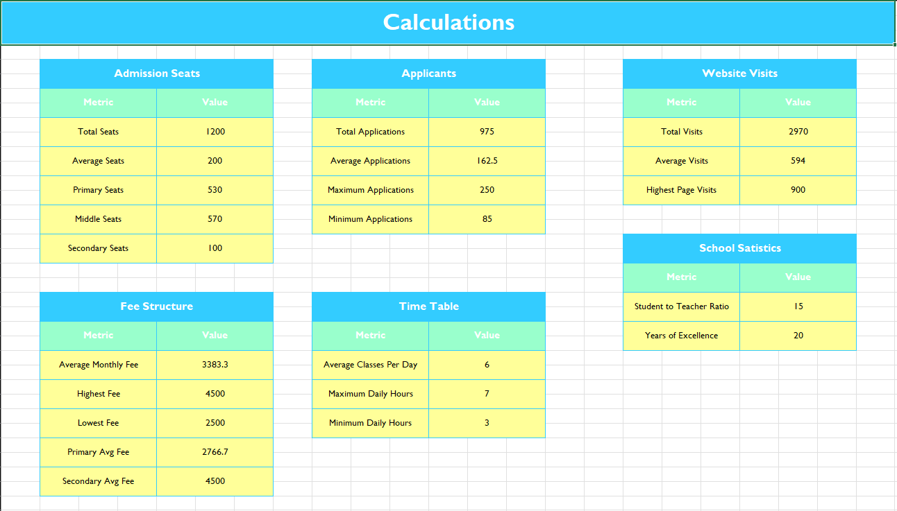
Data Analysis Using Microsoft Excel
Raw admission and fee data
collected
Calculations using SUM, AVERAGE,
and IF functions

Slide 8
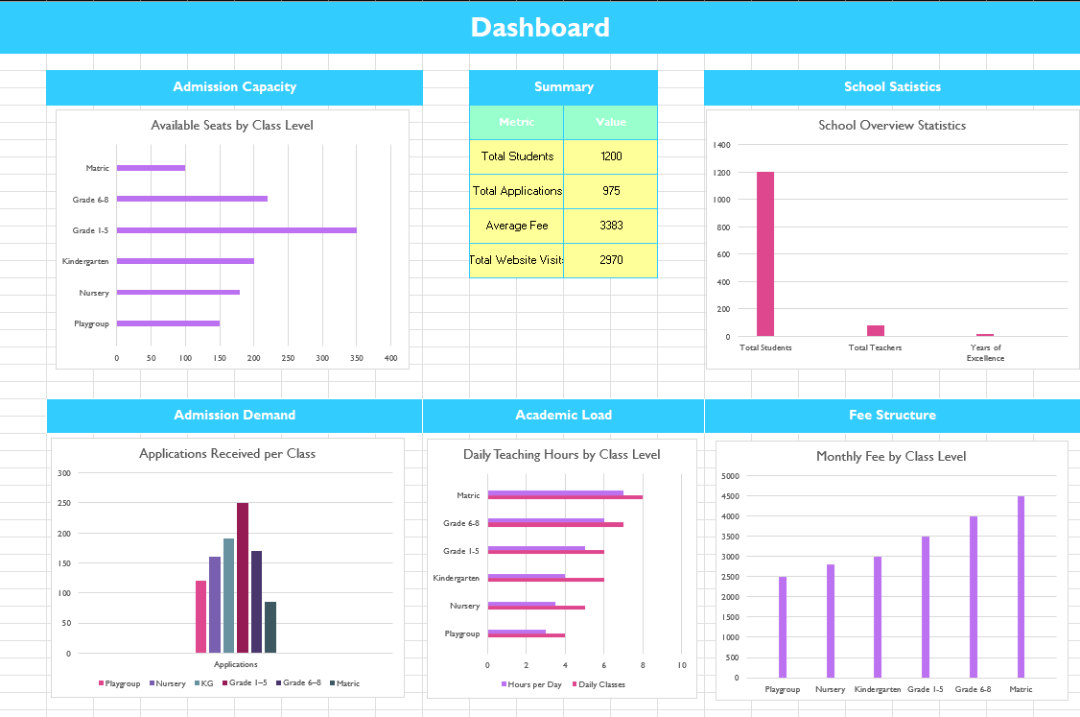
Excel Dashboard & Key Insights
Admission distribution and
website usage visualized.
Charts used for quick insights
and decision-making.

Slide 9
Design Decisions
Consistent color palette suitable for an educational institute
Clean typography for readability
Responsive layout using CSS media queries
User-focused navigation and structure

Slide 10
Live Website & GitHub Repository
🌐 Live Website: https://your-username.github.io/school-admission-portal/
💻 GitHub Repository: https://github.com/your-username/school-admission-portal
📌 Hosted using GitHub Pages

Slide 11
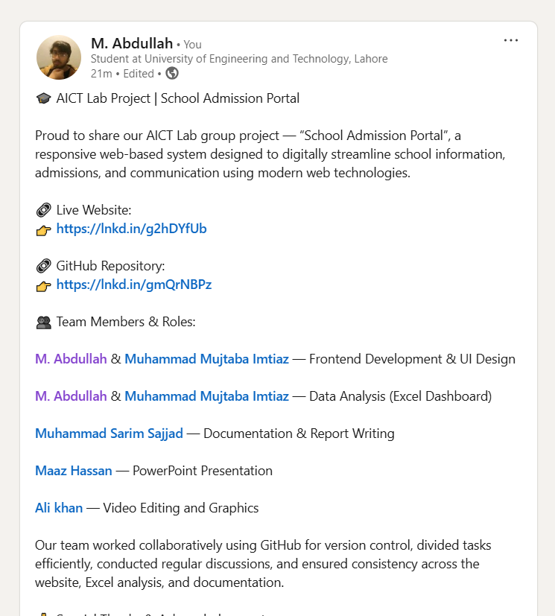
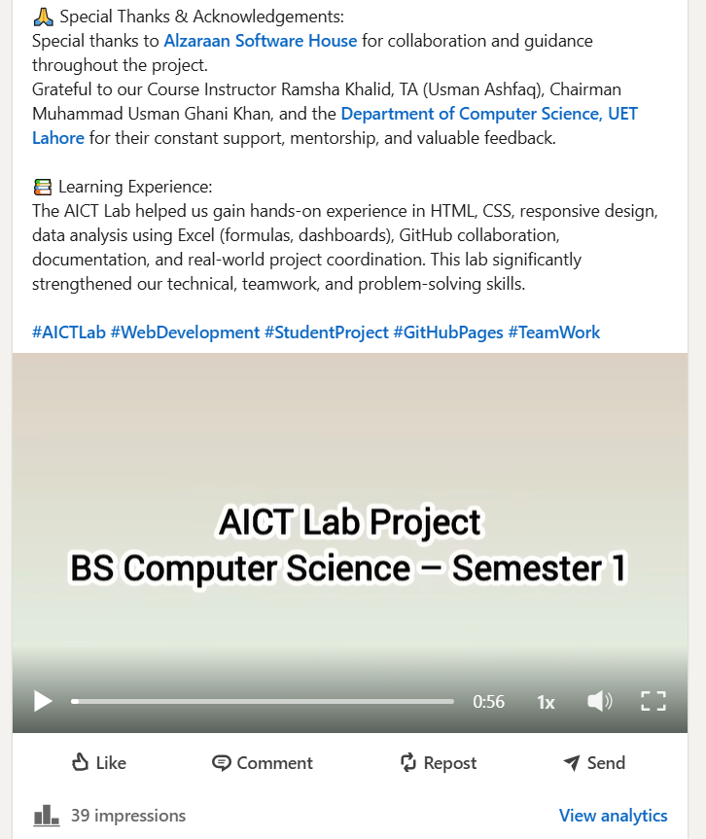
Professional Project Showcase
Team roles and acknowledgements highlighted
Project video and website shared on LinkedIn

Slide 12
Reflection & Future Enhancements
What We Learned
Web development using HTML & CSS
Data analysis using Excel dashboards
Team collaboration using GitHub
Future Improvements
Online admission form integration
Backend database support
Admin dashboard

